Slide 1
Hospital Management System
University of Asia Pacific
Md.Rafiqul Islam
Id:15101059

Slide 2
Contents
Introduction
Application
Platform
Working Demo
Future Work
Conclusion
Acknowledgement

Slide 3
Introduction
The following subsections of software Requirement Specification Document should facilitate in providing the entire of the Information System “Hospital Management System” under development. This document aims at defining the overall software requirements for nurse and doctor. Efforts have been made to define the requirements of the information exhaustively and accurately.

Slide 4
Application
Manage hospital from anywhere
Nice design
Doctor, nurse and other user dashboards
Billing and revenue management

Slide 5
Platform
Operator System : Windows 10
Language : Java
IDE : Netbeans 8.0.2
JVM : JDK
Database : SQL(sqlite-jdbc-3.7.2)

Slide 6
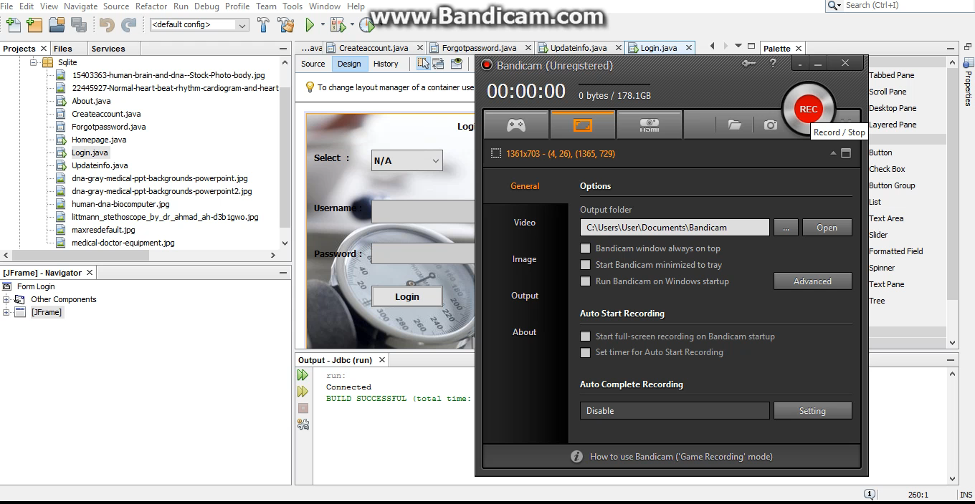
Working Demo

Slide 7
Future Work
The proposed System is “Hospital Management System". I can enhance this by including more facilities like pharmacy system for the stock details of medicines in the pharmacy providing such feathers enable the users to include more comments into the system

Slide 8
Conclusion
The project Hospital Management System (HMS) is for computerizing the working in a hospital. It is a great improvement over the manual system. The computerization of the system has speed up the process. In the current system, the office managing is very slow. The Hospital Management System was thoroughly checked and tested with dummy data and thus is found to be very
reliable.

Slide 9
It generates test report and also provides the facility for searching the details of the patient. It also provides billing facility on the bails of patient’s status whether it is an indoor or outdoor patient

Slide 10
Acknowledgement
The satisfaction that accompanies that the successful completion of any task.
Whose content guidance and encouragement crown all efforts with success
I am grateful to my project guide MR. Asif Hossain for the guidance ,inspiration and constructive suggestions that helpful my in the preparation of this project

Slide 11
I also thank my friends who have helped in successful completion of the Hospital Management System project

Slide 12
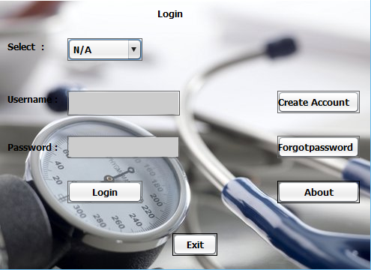
Login

Slide 13
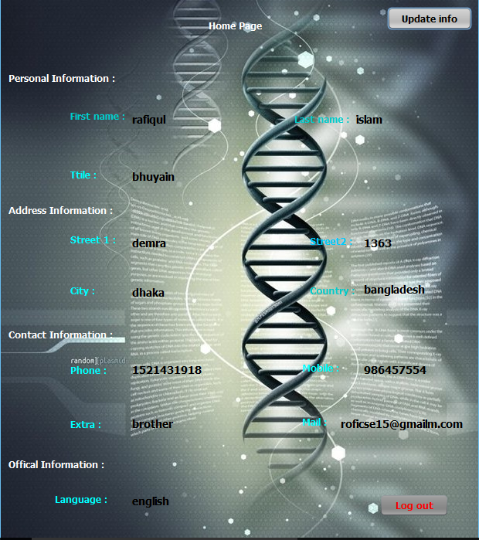
Home page

Slide 14
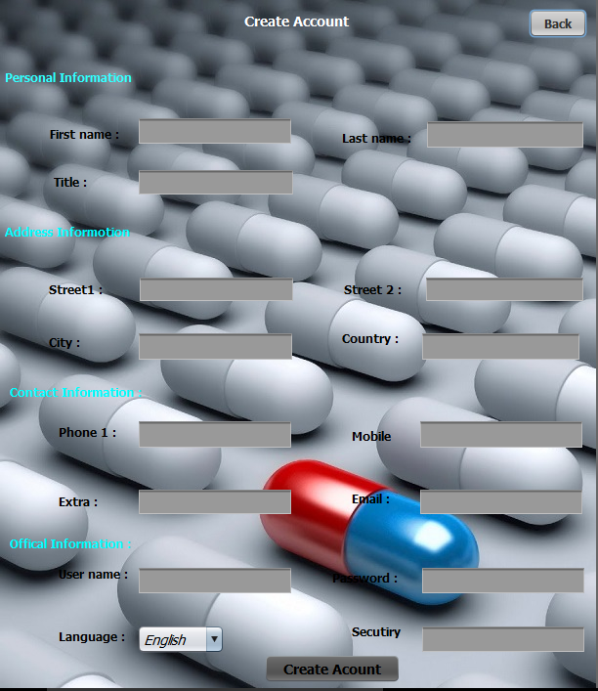
Create Account

Slide 15
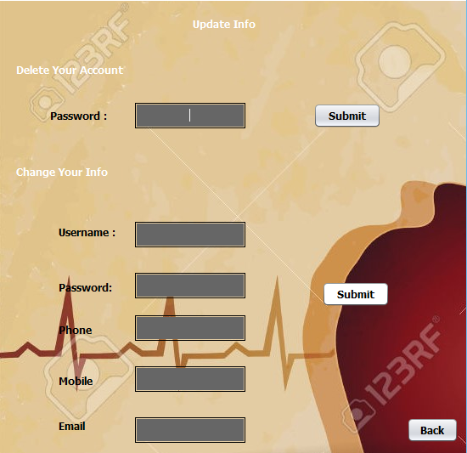
Update Info

Slide 16
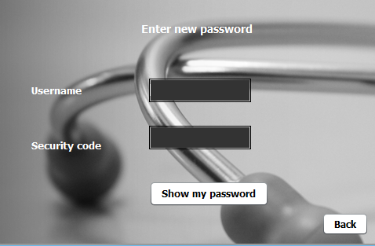
Forgot password

Slide 17
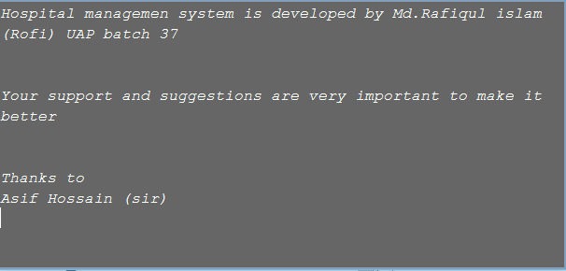
About

Slide 18

The End

